Slide 1

GA Representation, Initialization and Selection
Professor Bo Liu
James Watt School of Engineering

Slide 2
The workflow of GA
Initialization
x ={x¹, …, x^{M}}
x_{mat}={x¹_{mat} , …, x^{M}_{mat}}
Selection
Crossover
x_{cross}={x¹_{cross} , …, x^{M}_{cross}}
Mutation
x_{mut}={x¹_{mut} , …, x^{M}_{mut}}
No
Replacement
Termination conditions?
Yes
Save the optimal solution

Slide 3
Representation
An individual is encoded with some data structure.
individual
Binary String:
0 0 1 1
gene
decoding
encoding
3
Other representations:
permutation, real number, integer, etc.
7 | 2 | 5 | 3 | 1 | 4 | 6

Slide 4
Initialization
GAs starts from an initial population:
A population = a set of individuals
Two essential things to be considered :
Population size: how many individuals?
The initialization method: how to obtain the initial population?
The initial population can be obtained by random sampling.
1000
0110
0101
0111

Slide 5
Selection
The selection strategy simulates the natural selection method: survival of the fittest.
decides which individuals go into the mating pool.
give more chances to better individuals.
    determine “better” and “poorer” solutions by the fitness function.
Popular selection schemes: proportional selection, tournament selection, truncation selection

Slide 6
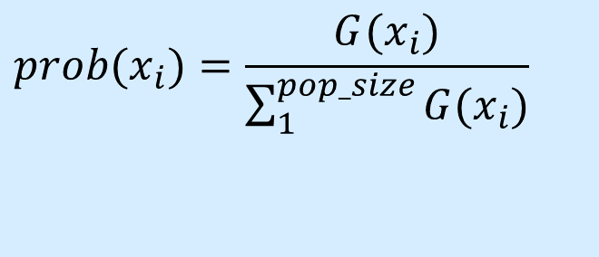
Selection
Proportional selection
Consider the problem of maximizing the function
max G(x) = −(x−8)²+65
where x is an integer and can vary between 0 and 15.
The probability of an individual becoming a parent
is proportional to its fitness
$$prob(x_{i})=\frac{G(x_{i})}{\sum_{1}^{pop_size}{G(x_{i})}}$$

Slide 7
Selection
Initial population (Generation 0) and corresponding fitness values:
i | chromosome x^{i} | G(x^{i}) | Prob(x^{i})
1 | 1011 | 56 | .55 | Maximum probability
2 | 0010 | 29 | .28
3 | 0001 | 16 | .16
4 | 0000 | 1 | .01 | Minimum probability

Slide 8
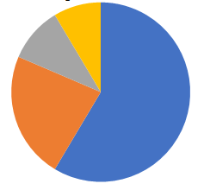
Selection
Roulette Wheel: implement proportional selection
Each individual occupies a part of the wheel with a size proportional to their fitness.
Turning the wheel allows for appropriate selection

Slide 9
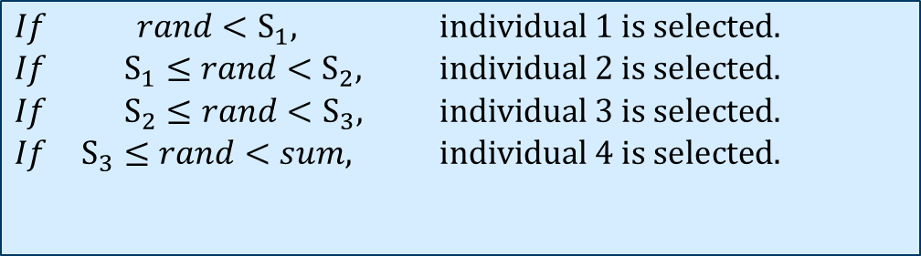
Selection
Roulette Wheel: implement proportional selection
Sum the fitness of all the population members: Sum (Sum=102)
Compute S₁= G₁, S₂= G₁ + G₂ , S₃= G₁ +G₂ + G_{3 ,} S₄= G₁ +G₂ +G₃ + G_{4.}
0 56 (S₁) 85 (S₂) 101 (S₃) 102 (S₄=Sum)
Generate a random number rand between 0 and Sum.
$$\begin{matrix}If & rand<S_{1}\text{, } & \text{individual}\text{ 1 }\text{is} \text{selected}\text{.} \\ If & S_{1}≤rand<S_{2}, & \text{individual}\text{ 2 }\text{is} \text{selected}\text{.} \\ If & S_{2}≤rand<S_{3}, & \text{individual}\text{ 3 }\text{is} \text{selected}\text{.} \\ If & S_{3}≤rand<sum\text{, } & \text{individual}\text{ 4 }\text{is} \text{selected}\text{.}\end{matrix}$$

Slide 10
Selection
Proportional Selection:
From population to mating pool
i | x^{i} | G(x^{i}) | Prob(x^{i}) | Mating Pool | G(x^{i})
1 | 1011 | 56 | .55 | 1011 | 56
2 | 0010 | 29 | .28 | 0010 | 29
3 | 0001 | 16 | .16 | 1011 | 56
4 | 0000 | 1 | .01 | 0001 | 16

Slide 11
Selection
The effect of selection:
Better individuals tend to have more copies in the mating pool.
Optimality | Mating pool > Previous Population | Selection guides the search into a promising area in the search space.
Diversity | Mating pool < Previous Population | Selection decreases the number of different candidates.

Slide 12
Selection
selection
Population
Mating
Pool
At last, all the members in the population will be same: the best one in the initial population.
Selection alone cannot solve the optimization problem.

Slide 13




Thanks!
#UofGWorldChangers
@UofGlasgow

